Slide 1
Big Data - LRC
LRC Internal technical session

Slide 2
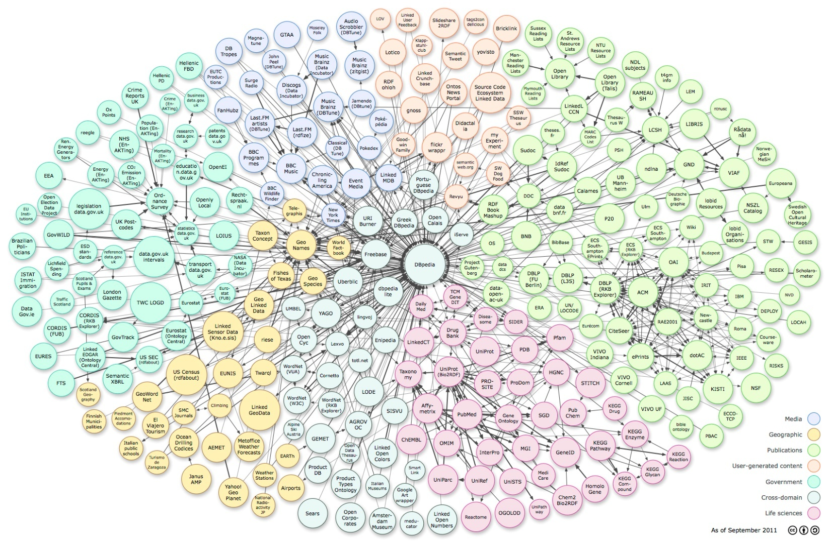
What is Big Data
a process of changing data into information and knowledge

Slide 3
Opportunities and challenges to IT professionals
Chief Data Officer
Data Scientists
Data Engineers
Data Analysts
Data Visualizers
Data Managers
Data Consultants
Data engineers enable data scientists to do their jobs more effectively!
The data engineer gathers and collects the data, stores it, does batch processing or real-time processing on it, and serves it via an API to a data scientist who can easily query it.
A good data engineer has extensive knowledge on databases and best engineering practices. These include handling and logging errors, monitoring the system, building human-fault-tolerant pipelines, understanding what is necessary to scale up, addressing continuous integration, knowledge of database administration, maintaining data cleaning, and ensuring a deterministic pipeline.

Slide 4

Hadoop
Apache, open source
A distributed data operating system – capable of processing thousands of terabytes dataset
Runs on commodity hardware – tolerance of system failure
An ecosystem
Two aspects of Hadoop:
- Parallel data processing – Map Reduce
- Distributed Data Persistence – enables NoSQL Database

Slide 5
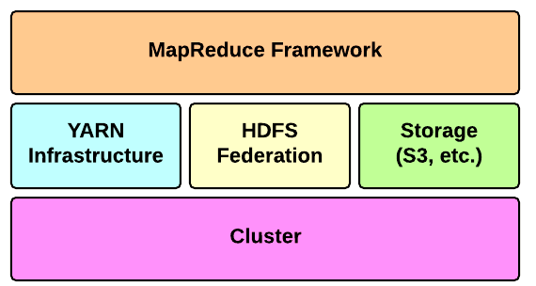
Hadoop Architecture

Slide 6
Hadoop Architecture
MapReduce – a framework to process data in parallel on large cluster
HDFS – Hadoop Distributed File System
YARN – Yet Another Resource Negotiator
Hadoop IO – dealing with terabytes of dataset
Clustered

Slide 7
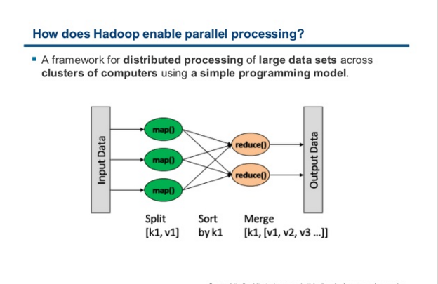
Map Reduce

Slide 8
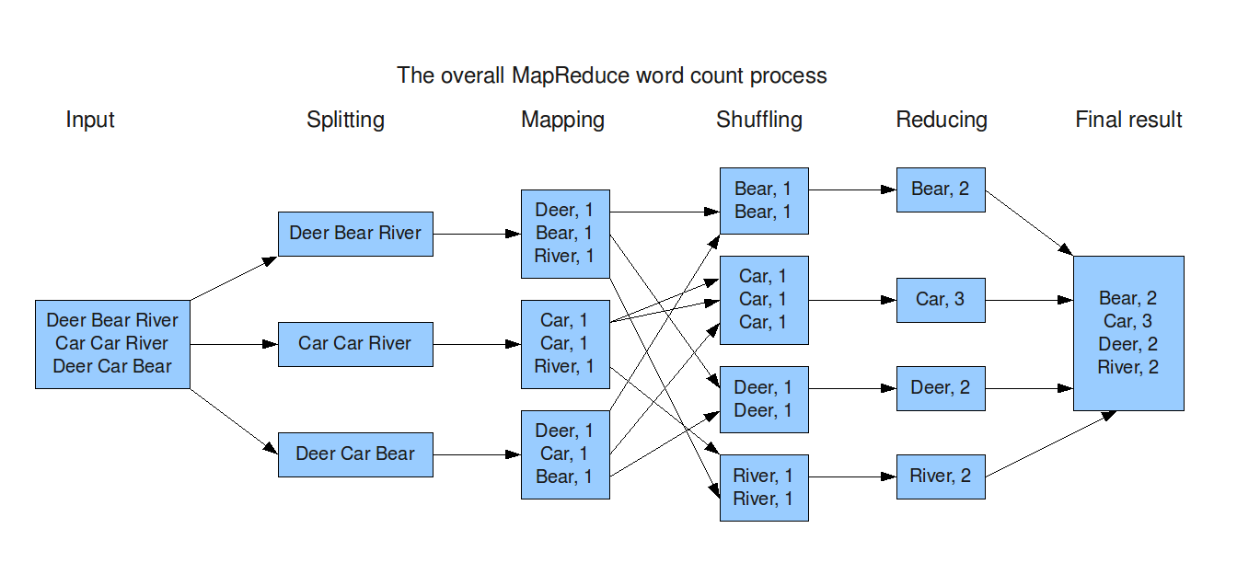
Map Reduce

Slide 9
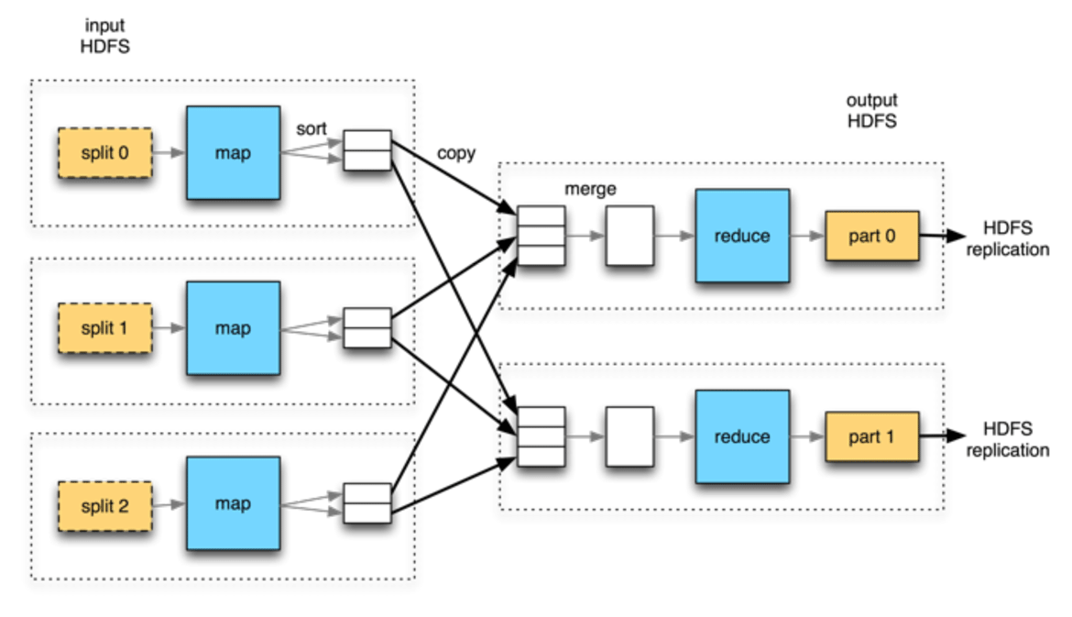
Map Reduce

Slide 10
Map Reduce
Heart of Hadoop, initiated by Google
map : maps input key/value pairs to a set of intermediate key/value pairs
reduce: reduces a set of intermediate values which share a key to a smaller set of values.
partitioner: partitions the key space
counter: a facility for MapReduce applications to report its statistics
Job: the primary interface to describe a MapReduce job to the Hadoop framework for execution
Job Tracker: schedules Tasks where the data resides

Slide 11
Map Reduce
Task Execution: The MRAppMaster executes the Mapper/Reducer task as a child process in a separate jvm
Job Control: submit, track, access reports and logs, access status of the MR jobs
Hadoop Streaming: using user defined mappers and reducers

Slide 12
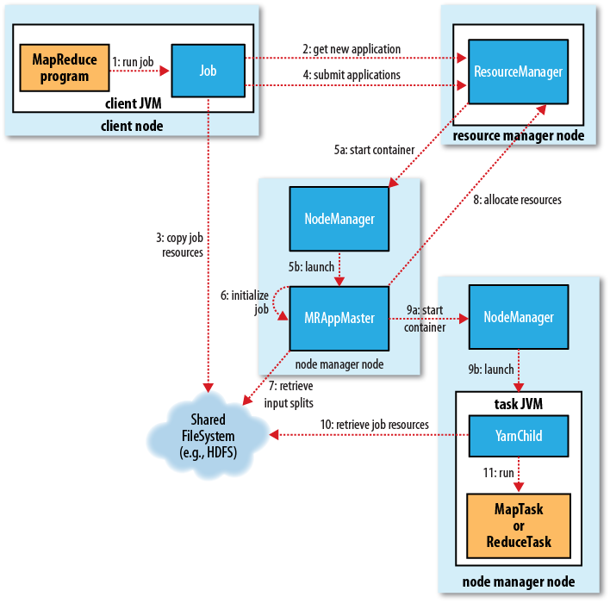
Map Reduce

Slide 13
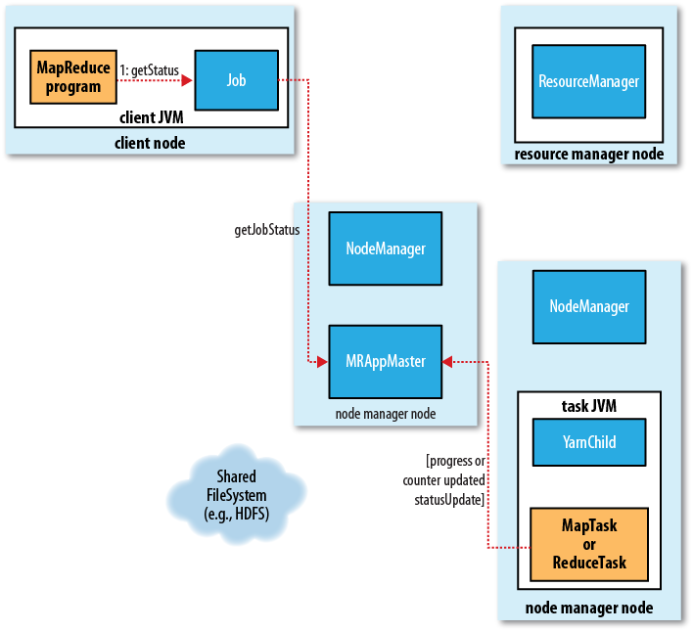
Map Reduce – job status

Slide 14

HDFS

Slide 15
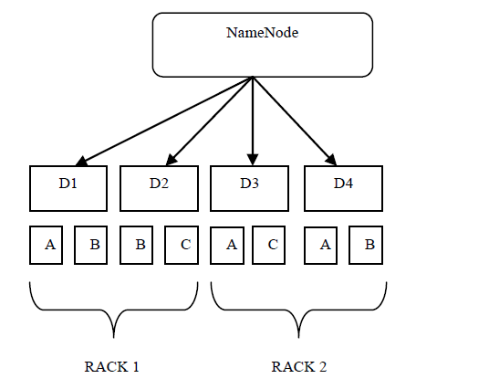
HDFS

Slide 16
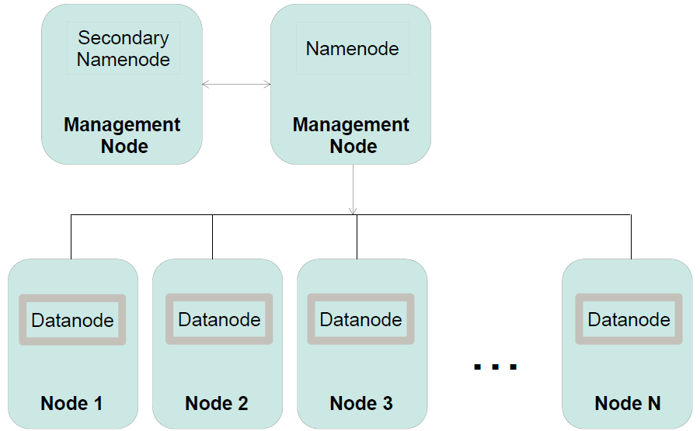
HDFS

Slide 17
HDFS
Hadoop Distributed File System on commodity hardware
Namenode
manages the File System's namespace/meta-data/file blocks
Runs on 1 machine to several machines
Datanode
Stores and retrieves data blocks
Reports to Namenode
Runs on many machines
Secondary Namenode
Performs house keeping work so Namenode doesn’t have to
Requires similar hardware as Namenode machine
Not used for high-availability – not a backup for Namenode

Slide 18
HDFS
Interesting features than POSIX compliant OS file systems:
Rack awareness (Locality: shipping the computation is less expensive than shipping data)
Highly Scalable, Fault Tolerance, and expandable
Large Data Block: 64M vs 4K
Web Interface Access, Shell Access, WebHDFS, RESTful support,
Heterogeneous Storages Support

Slide 19
HDFS
Store input and output, but not intermidiate
Other storage solutions: Amazon S3, Microsoft Azure, etc.
Federation: Local File System, NFS, FTP, HTTP, HTTPS, etc

Slide 20
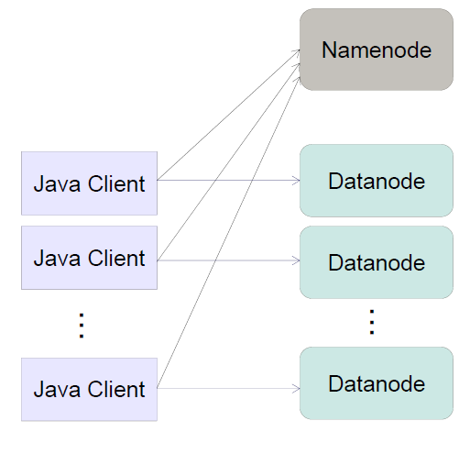
HDFS Direct Access

Slide 21
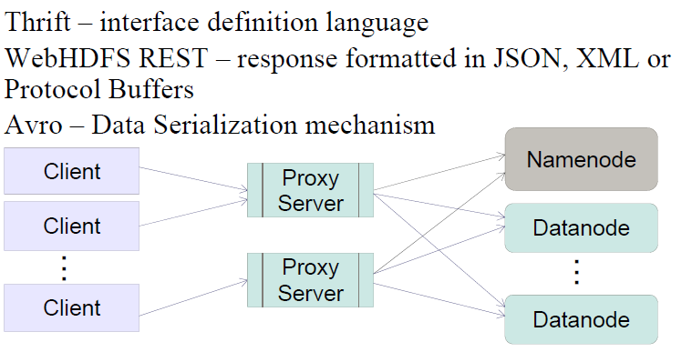
HDFS Proxing access

Slide 22
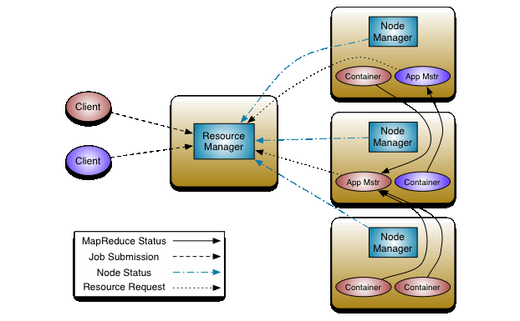
Hadoop Yarn

Slide 23
Hadoop Yarn
Resource Manager: Scheduler + ApplicationsManager, one per cluster
Scheduler: allocating resources to the various running applications – Fair Scheduler, Capacity Scheduler, Lazy Scheduler …
ApplicationsManager: accepting job-submissions, negotiating container for executing the application specific ApplicationMaster , etc.
NodeManager: per-machine framework agent responsible for containers, monitoring their resource usage (cpu, memory, disk, network) and reporting to the ResourceManager/Scheduler. Many per cluster
ApplicationMaster: per-application agent that is responsible for negotiating resource containers from the Scheduler, tracking status and monitoring progress.
Container: a unit of resource allocation – i.e., 1 CPU, 2G Memory, etc.

Slide 24
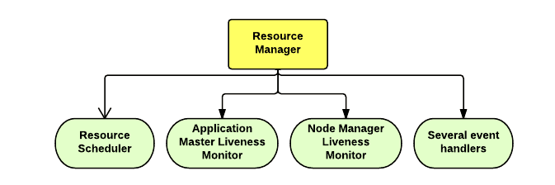
Yarn – Resource Manager

Slide 25
Yarn – Resource Manager
arbitrates available cluster resources, manage the distributed application, works together with the NodeManagers (NMs) and ApplicationMasters
Components:
ApplicationsManager
ApplicationMasterLauncher
YarnScheduler
ContainerAllocationExpirer

Slide 26
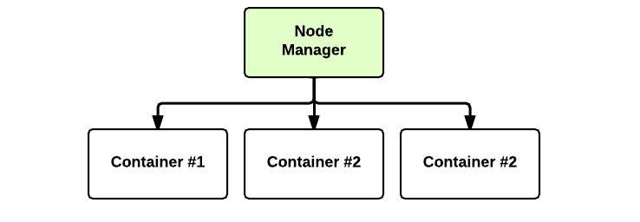
Yarn – Node Manager

Slide 27
Yarn – Node Manager
Manages individual nodes – communicate with RM, manage node life-cycle, monitoring containers, tracking, logging, etc.
Components:
NodeStatusUpdater
ContainerManager
ContainerExecutor
NodeHealthCheckerService

Slide 28
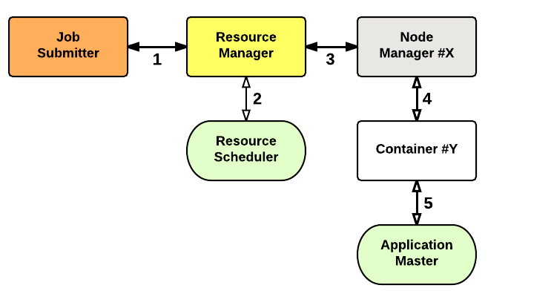
Yarn

Slide 29
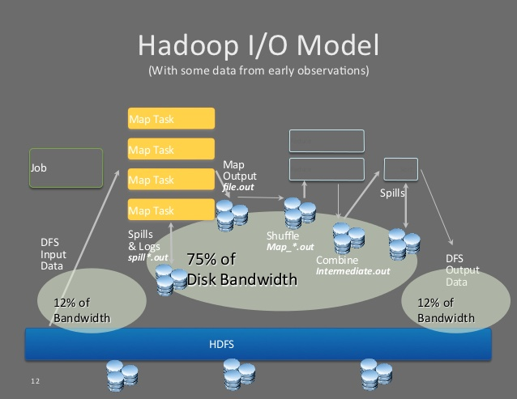
Hadoop IO

Slide 30
NoSQL
Not Only SQL
Unstructured dataset
Distributed database, stored across multiple processing nodes, highly scalable.
NoSQL Data Stores:
Key-Value Store, Document Store, Graph Store, Column-Oriented Store …

Slide 31
Hadoop Ecosystem
Distributed Filesystem – Apache HDFS,
Distributed Programming – Hadoop MapReduce, Apache Pig, Apache Spark
NoSQL Database – Apache Cassandra (hybrid between a key-value and tabular database), MongoDB (Document based), Apache HBase (column based)
Data Ingestion – Apache Flume, Apache Storm, Apache Kafka.
Service Programming – Apache ZooKeeper
Scheduling – Apache Oozie
Machine Learning – Apache Mahout
Pig and Hive - higher-level abstractions of MapReduce
And a lot more …

Slide 32
Hello World
Hadoop 2.7.1 on ubuntu – built from source
start HDFS – start-dfs.sh
start YARN: start-yarn.sh
Format data node - hdfs namenode –format
Restart hdfs: stop-dfs.sh, start-dfs.sh
Create user directory:
hdfs dfs -mkdir /user
hdfs dfs -mkdir /user/hduser
Copy file to HDFS: hdfs dfs -put files input
Run the application: hadoop jar wc.jar input/file01 output
Check the result: hdfs dfs -cat output/*

Slide 33
Hadoop Spark
Distributed computation framework – part of Hadoop ecosystem
Does not use MapReduce Engine
fast and general-purpose cluster computing system: 100x faster than Hadoop MapReduce in memory, or 10x faster on disk – improvement of Map Reduce framework
APIs in Java, Scala, Python and R
Spark SQL, Machine Learning, Graph Processing, Spark Streaming
Spark Data: RDD, DataFrame, Dataset

Slide 34
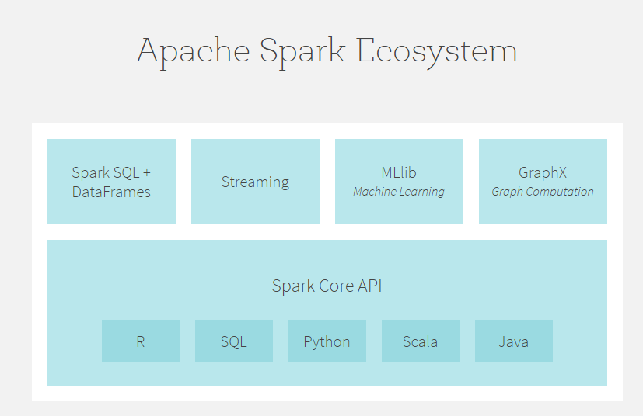
Spark Components

Slide 35
Spark - continue
Spark core: general execution engine, in-memory computing, data source access
Spark SQL: provides support for structured and semi-structured data
Spark Streaming: scalable, high-throughput, fault-tolerant stream processing of live data streams – data ingestion.
Machine Learning Library: much faster than Apache mahout (Hadoop ML library)
GraphX: Graph Processing library

Slide 36
Spark RDD
RDD: Resilient Distributed Datasets
Immutable, fault tolerance, distributed
Transformation: a new RDD without evaluation
e.g.: filter(), map()
Action: evaluates and returns a new RDD
e.g.: count()

Slide 37
Spark Dataset and DataFrame
Dataset: distributed collection of data
DataFrame: a Dataset organized into named columns (table).
represented as Dataset of Rows (Dataset[Row])
constructed from structured data files, Hive tables, external databases, or existing RDDs
Unified in Spark 2.0

Slide 38
What’s new in Spark 2.0
Release July 26, 2016
Spark Session – replace SQLContext and HiveContext
Unifying DataFrame and Dataset
DataFrame based ml package become primary (instead of mllib – RDD based)
More R support

Slide 39
Scala vs. R vs. Python vs Java
Java is out
R: widely used by statisticians and data miners for developing statistical software and data analysis
Python: Rich machine learning library, popular script language. Does not support Dataset
Scala: support functional programming, better spark integration, better performance.

Slide 40
Spark Machine Learning
Machine Learning: a method of data analysis that automates analytical model building. Using algorithms that iteratively learn from data, machine learning allows computers to find hidden insights without being explicitly programmed where to look
Spark ML library: regression, classification, clustering

Slide 41
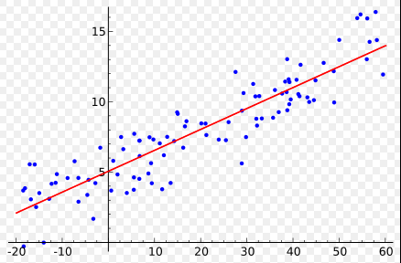
Spark ML: Regression
a statistical process for estimating the relationships among variables
widely used for prediction and forecasting

Slide 42
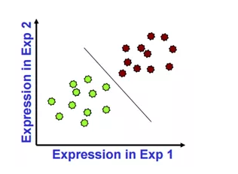
Spark ML: Classification
We have labels for some points, and we want a ‘rule’ that will accurately assign labels to new points.

Slide 43
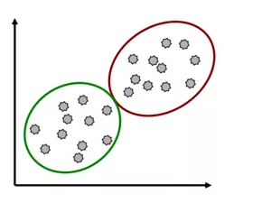
Spark ML: Clustering
We group points into clusters based on how ‘near’ they are to one another

Slide 44
Regression vs Classification vs. Clustering
Regression: the target variable is continuous
e.g.: predict temperature, a stock price
Classification: the target variable is categorical
e.g.: predict a score of PASS or FAIL
Clustering: group the data into some number of clusters
e.g.: analyze shopping patterns and make recommendations.

Slide 45
Predictive Analytics Process
Business Definition
Data collection
Data cleaning/Data Regularization
Model selection
Model training
Model Testing
Deployment

Slide 46
Popular analytic models
Regression: Linear regression, ElasticNet Regression
Classification: Logistical regression, decision tree, Naïve Bayes, SVM (Support Vector Machine).
Clustering: Kmean, Gaussian
80% problems can be solved by 20% models
Life can be easier: continuous prediction: Linear regression; binary classification: Logistic regression

Slide 47
Machine Learning Resources
Apache PredictionIO – machine Learning server, incubating. http://predictionio.incubator.apache.org
Apache Mahout: machine learning library; MapReduce is phasing out, Support of Spark. http://mahout.apache.org/
Google Machine Learning, on cloud
https://cloud.google.com/ml/
TensorFlow: brain behind DeepMind
https://www.tensorflow.org/

Slide 48
HWIN problem
HWIN license renewal: February 15
Failure of renewal cost ministry significant capital
Analyze the user behaviour, predict the expiring companies (generators), making pro-active actions
Data from 2002 - 2016

Slide 49
HWIN Predictive Analytics
A classification question: EXPIRE (1), NOT EXPIRE (0)
Features selection: <expiry history, number of manifests>
Use 2012-2015 renewal history
Label: 0 - renewed; 1 - expired
Training data: Historic Data from 2012 – 2015, renewal status in 2016
Training/Testing : 70%/30%
Logistical Regression – a binary classification model (not a regression model)
Naïve Bayes – bases on probability of the features

Slide 50
HWIN predictive Analytics
Scala on spark, ml library, classification
Using csv package from databricks
Prediction using Logistic Regression: 5649/6508 ~ 86%, RMSE = 0.37
Prediction using NaiveBayes: 5254/6508 ~ 80%, RMSE = 0.44
Root Mean Squared Error: an estimate of the standard deviation of the model

Slide 51
HWIN Predictive Analytics – possible Improvement
Add waste class as predictive feature
Identify outliers
Regularization
Try decision tree classification model
Try random forest classification model

Slide 52
Questions

